Slide 1
SALARY PREDICTION
PRESENTATION BY
HARSHIT GOEL(1816110081)
MAYANK BORA(181110110)

Slide 2
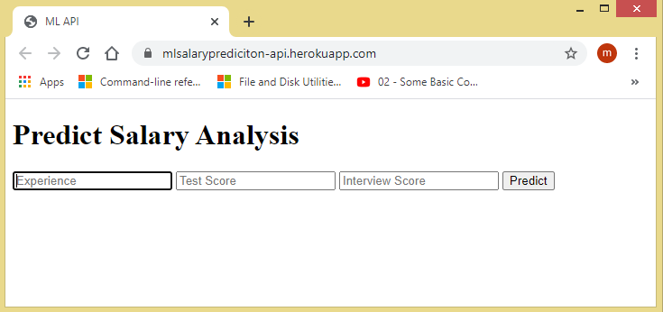
INTRODUCTION
The objective is to build a web app to predict salary of a particular person on the basis of their experience, test score and interview score by using python and machine learning tools and techniques .
Here is the link of the app:-
https://mlsalaryprediciton-api.herokuapp.com/

Slide 3
LIBRARIES AND LANGUAGE USED
NUMPY
PANDAS
MATPLOTLIB
SKLEARN
PYTHON LANGUAGE
We have also used a supervised machine learning algorithm which is linear regression.
Deployment of machine learning model in done in heroku using flask

Slide 4
ABOUT PYHTON
In our project we have used python language. It is an interpreted, high-level and general-purpose programming language. Python's design philosophy emphasizes code readability with its notable use of significant whitespace. Its language constructs and object-oriented approach aim to help programmers write clear, logical code for small and large-scale projects.
We have used NumPy and Pandas which have emerged to be essential libraries for any scientific computation, including machine learning, in python due to their intuitive syntax and high-performance matrix computation capabilities.

Slide 5
MACHINE LEARNING
Machine learning is the study of computer algorithms that improve automatically through experience. It is also seen as a subset of artificial intelligence. Machine learning algorithms build a model based on sample data also known as "training data", in order to make predictions or decisions without being explicitly programmed to do so. Machine learning algorithms are used in a wide variety of applications, such as email filtering and computer vision, where it is difficult or unfeasible to develop conventional algorithms to perform the needed tasks.

Slide 6
WHAT IS HEROKU?
Heroku is a cloud platform as a service supporting several programming languages . Initially heroku supported only the Ruby programming language, but now it supports Java, Node.js, Scala, Clojure, Python, PHP, and Go programming languages. For this reason, Heroku is said to be a polyglot platform as it has features for a developer to build, run and scale applications in a similar manner across most languages.

Slide 7
FLASK
Flask is an API of Python that allows us to build up web-applications. It was developed by Armin Ronacher. Flask’s framework is more explicit than Django’s framework and is also easier to learn because it has less base code to implement a simple web-Application.
A Web-Application Framework or Web Framework is the collection of modules and libraries that helps the developer to write applications without writing the low-level codes such as protocols, thread management, etc. Flask is based on WSGI(Web Server Gateway Interface) toolkit and Jinja2 template engine.

Slide 8
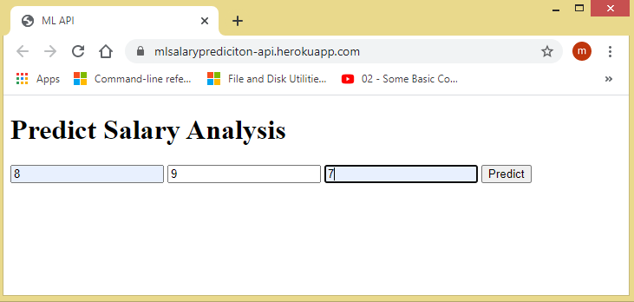
PICKLING
Python pickle module is used for serializing and de-serializing a Python object structure. Any object in Python can be pickled so that it can be saved on disk. What pickle does is that it “serializes” the object first before writing it to file. Pickling is a way to convert a python object into a character stream. The idea is that this character stream contains all the information necessary to reconstruct the object in another python script.

Slide 9
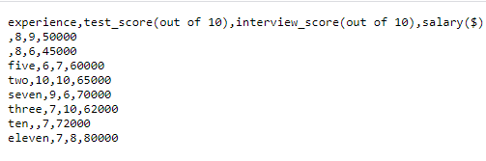
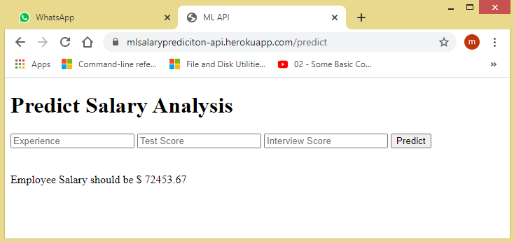
ABOUT THE DATASET
The dataset contains following fields:
Experience
Test Score
Interview Score
Salary
If we enter the value of experience , test score and interview score 8, 9 and 7 respectively then it will show thee following output.

Slide 10
THANK YOU

